Slide 1

Landmark Cases and Decisions

Slide 2
what is landmark decisions?
A landmark decision merely is a decision that is usually cited because it significantly varies, updates consolidate or excellently summarizes the law on a particular topic.
A landmark decision, also known as a landmark court decision.
It founds new precedents that, in turn, establishes a significant new legal concept or principle.
Or it brings new interpretations of prevailing law (Ritz et al., 2019).
In commonwealth states, such decisions are referred to as leading decisions.

Slide 3

Landmark cases
A landmark case is a court case that has to be studied since it has legal and historical significance.
The most significant cases are the one with an everlasting effect that can be applied to certain laws, especially regarding individual liberties and rights (Handler et al., 2017)

Slide 4
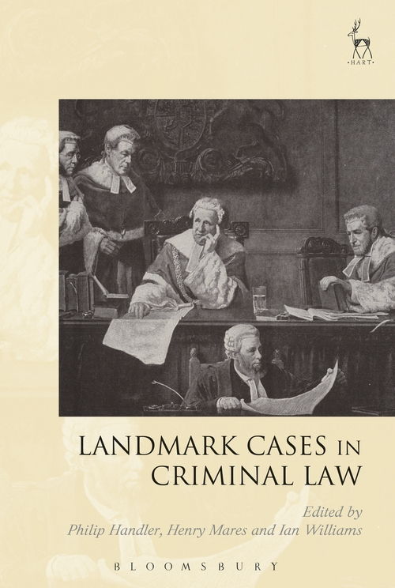
How do court cases affect the law?
Although the judicial system is not directly involved in law-making, they interpret laws through the cases presented before the courts.
Mostly, the judges base their final decisions following previous rulings made by the court in similar circumstances.

Slide 5
Cont’d
Frequently, judicial systems will try to stay consistent in ruling similar cases and issues.
And so, the last final decision made by higher courts becomes part of the law.
Decisions made by the higher courts should be followed by the national trial courts (Juss & Sunkin, 2017). This is referred to as the following precedent.

Slide 6
What are Future Issues that may result in landmark cases?
Abortions and birth controls
Power congress to enforce civil rights
Discrimination based on ethnicity and race
Discrimination based on gender ( gender inequality)
Discrimination based on sexual orientation
voting rights
Workers rights

Slide 7
References
Ritz, C., Marx, C., & Bogenreuther, M. (2019). Prima Facie Evidence in Cartel Damages Litigation–Landmark Decision by the German Federal Court of Justice in the Rail Cartel Case. Journal of European Competition Law & Practice.
Ritz, C., Marx, C., & Bogenreuther, M. (2019). Prima Facie Evidence in Cartel Damages Litigation–Landmark Decision by the German Federal Court of Justice in the Rail Cartel Case. Journal of European Competition Law & Practice.
Juss, S., & Sunkin, M. (Eds.). (2017). Landmark Cases in Public Law. Bloomsbury Publishing

